Slide 1
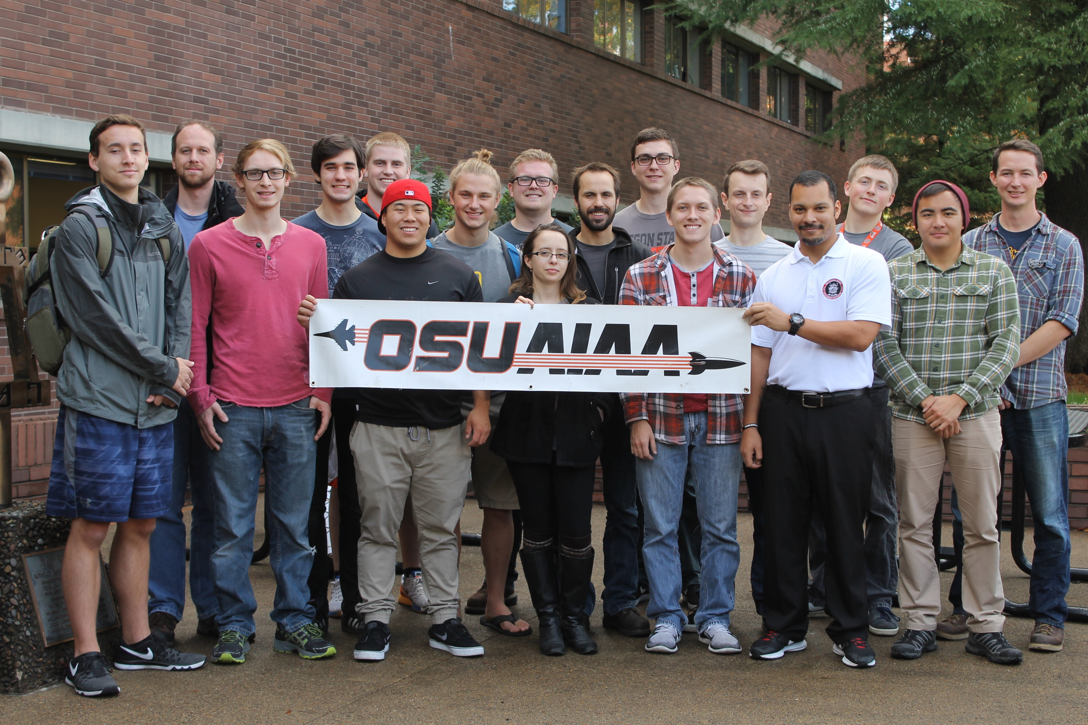
Fall Progress Report
Team #25
Natasha Anisimova, Terrance Lee, Albert Morgan

Slide 2

Introduction: The Problem
Launch a rocket in the Black Rock Desert
Receive telemetry and visualize in real-time
Aid in recovery
Track rocket
Log telemetry for later retrieval
Create a usable user interface

Slide 3
Our Clients
High-Altitude Rocketry Team
Led by Dr. Nancy Squires
Clients are engineering students
Software team given a lot of flexibility

Slide 4
Telemetry
Receive telemetry from the rocket over packet radio
Translate to serial protocol by avionics team
Read by Raspberry Pi through serial port
COCOM limits will cause us to lose GPS data
Create location prediction system

Slide 5
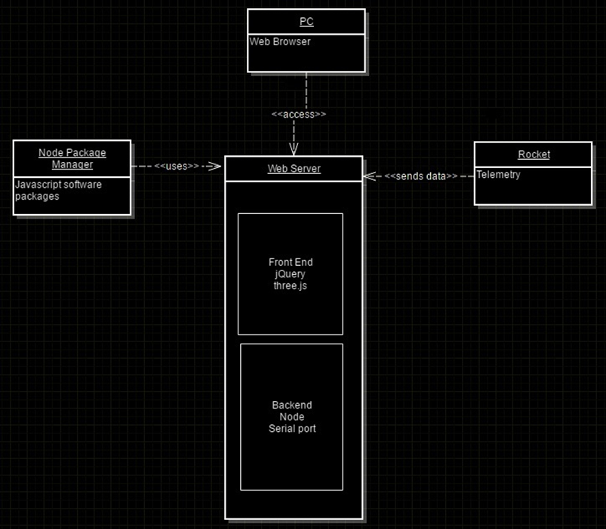
Backend
Raspberry Pi
Backend written in Node
One language (JavaScript) for whole system
Reuse libraries
One package manager (NPM)
Event driven architecture
Fast
Telemetry converted to JSON and transferred to client

Slide 6
Frontend and Web Browser
WebGL
3.js
Nik- Scientific Visualization

Slide 7
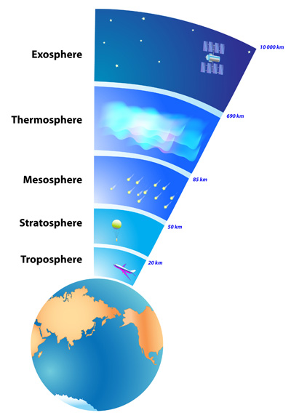
User Interface
3D Environment
3D View
Numerical Data
Data Visualization
Mike Bailey

Slide 8
Retrospective of the past 10 weeks
Met OSU AIAA Chapter Team (High-Altitude Rocketry Team)
Setup Communication Lines
Overview of Documents
Issues

Slide 9
Plans
Create terrain rendering prototype
How to render distant terrain efficiently?
Better work tracking system
GitHub issues
GitHub projects
Waffle.io?
Start on backend in Winter term
Test flight in March

